Slide 1
Operating system Lecture ten part1
Dr jamal altuwaijari

Slide 2
10. Virtual Memory
Virtual memory is a technique which allows the execution of processes that may not be completely in memory. The main advantage of this scheme is that the user programs can be larger than physical memory.

Slide 3
10.1. Demand Paging
Virtual memory describes a set of techniques that allow us to execute a program which is not entirely in memory. Demand paging is the most common virtual memory system. Demand paging is similar to a paging with swapping where programs reside on a swapping device, (the backing store) when we want to execute a program we swap it into memory. Rather than swapping the entire program into memory we use a lazy swapper, which is never swaps a page unless it is needed. If the program thies to access a page which was not brought into memory then a page fault will occur. The procedure is quite simple as in the ﬁgure 10.2.

Slide 4
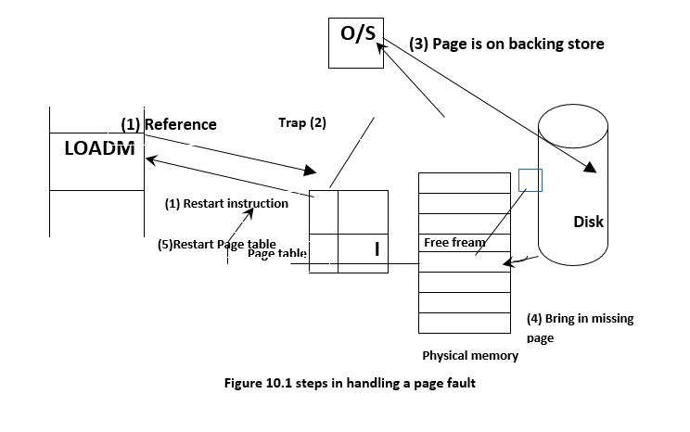
10.1. Demand Paging

Slide 5
10.2. Performance of Demand Paging:
Demand paging can have a signiﬁcant effect on the performance of a c/s. The effective access time for a demand — paged memory = (l-p) X ma + p * page fault time. Where p the probability of a page fault (o < p<l). And ma: The memory access time for most c/s now range from 10-200 nanoseconds.
.'. Effective access time for demand-paged memory affected by the time needed to service a page fault where there are three major components of the page fault service time:
a. Service the page fault interrupts.
b. Swap in the page.
c. Restart the process.
The following figure 10.2 Show the organization of page table when some pages are not in main memory.

Slide 6
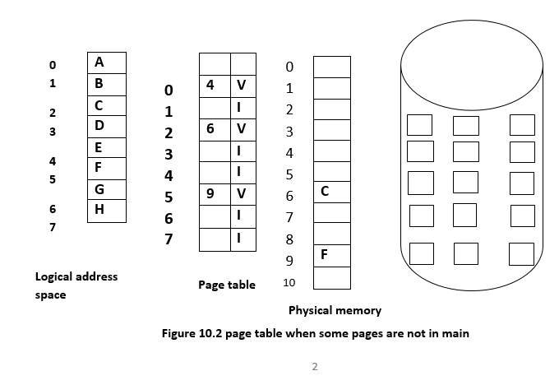
10.2. Performance of Demand Paging:

Slide 7
10.3 Page Replacement
When any process is executing and a page fault occurs, the l-l/W traps to O/S which checks its internal tables to see that this is a page fault not an illegal memory access. The O/S determines where the desired page is residing on the disk but then ﬁnds there are no free frames on the free-frame list, all memory in use, so we need to use the page replacement.
Page Replacement: It means if no frame is free we find on that is not currently being used and free it by writing its contents to swap space and changing the page table and all other tables to indicate that the page is no longer in memory see The page—fault service routine Is new modiﬁed to Include Page replaces.

Slide 8
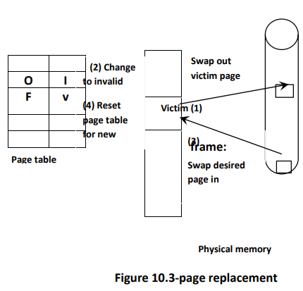
1. Find the location of the Desired page on the disk.
2. Find a free frame:
a. If there is a free frame use it.
b. Otherwise use a page-replacement
Alg.to select a victim frame.
c. Write the victim page to the disk and
Change the P.T.
3. Read the desired page into the free
frame. And Change the P.T.
4. Restart the user process.

Slide 9
10.4. Page— Replacement Algorithms:
There are many different page—replacement algorithms. Every o/s has its own unique replacement scheme .In general we want the one with the lowest page-fault rate.
If we trace a process we might record the following address sequence l, 4, l, 6,1,6,16,1.
The above addresses reduced to the page number for simplicity and the number called the reference string.
To determine the number of page faults for a particular reference string and page-replacement and the number of frames available where as the number of frames
Available increase. The number of page faults will decrease in general we expect a curve
Such as the in the following ﬁgure 10.4.
To illustrate the page-replacement algorithms we shall use the reference string.

Slide 10
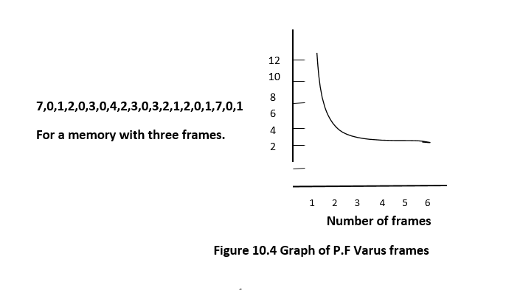

Slide 11
1. FIFO Algorithm
The simplest page-replacement algorithms 5 a FIFO when that page was brought into memory. When the page must replace the oldest page is chosen. We can create a FIFO queue to hold all pages in memory, and replace the page at the head of the queue. When a page is brought into memory we insert it at the tail of the queue.
Example
Consider the: following page reference string use three frames are initially empty. Show how
The page faults and are brought into these frames using the FIFO algorithm.

Slide 12
7 0 1 2 0 3 0 4 2 3 0 3 2 1 2 0 1 7 0 1
1 2 3 4 5 6 7 8 9 10 11 12 13 14 15
7 |  | 7 |  | 7 |  | 2 |  | 2 |  | 2 |  | 4 |  | 4 |  | 4 |  | 0
 |  | 0 |  | 0 |  | 0 |  | 3 |  | 3 |  | 3 |  | 2 |  | 2 |  | 2
 |  |  |  | 1 |  | 1 |  | 1 |  | 0 |  | 0 |  | 0 |  | 3 |  | 3
 | 0 |  | 0 |  |  | 7 |  | 7 |  | 7
 | 1 |  | 1 |  |  | 1 |  | 0 |  | 0
 | 3 |  | 2 |  |  | 2 |  | 2 |  | 1

Slide 13
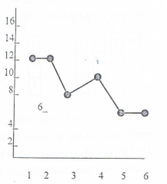
The page faults = 15.
The FIFO alg. Is easy to understand and program. But its performance is not always good. To illustrate the problems that is possible with a FIFO page replacement. Consider the
Reference string
1,2,3,4,1,2,5,1,2,3,4,5

Slide 14
If draw the curve of page faults versus the number of available frames, we notice that the number of faults for Four frames (10) is greater than the number of faults for three frames. This result is most Unexpected and known as Belays anomaly. It means the page faults rate may increase as
The number of free frames increased.

